Slide 1

Single-board Microcontroller (I) Artificial Intelligence of Things (SWS3025) NUS SoC Summer Workshop 2024
Lecture 2
Lecturer: A/P TAN Wee Kek
Email: tanwk@comp.nus.edu.sg :: WeChat :: tanweekek

Slide 2

Learning Objectives
At the end of this lecture, you should understand:
Overview of single-board microcontrollers.
Overview of the micro:bit.
Technical characteristics and features of micro:bit.
Programming micro:bit with blocks and JavaScript.
Working with micro:bit onboard sensors.
Working with micro:bit computational and communication capabilities.

Slide 3

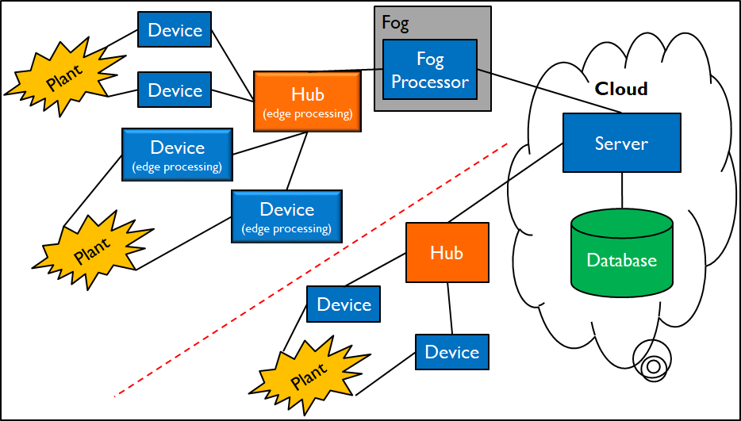
Technical Roadmap
Single-board Microcontroller
Android Wear
Single-board Computer
Android App
Server-side Backend Integration
AI & ML

Slide 4
Overview of Single-board Microcontrollers
A single-board microcontroller:
Is built on a single printed circuit board.
Contains all the circuitry necessary to perform a useful control task:
A microprocessor.
I/O circuits.
A clock generator.
RAM.
Stored program memory.
Any other necessary support ICs (integrated circuits).
Can be used immediately by an application developer without the need to develop own controller hardware:
Save time and effort.

Slide 5
Overview of Single-board Microcontrollers (cont.)
Microcontrollers can be used to automate the controlling of various products and devices:
E.g., automobile engine control systems, remote controls, office machines, appliances, power tools, toys and other embedded system.
By using microcontrollers, we can reduce the size and cost of devices compared to alternative designs that are based on a separate microprocessor.
Microcontrollers make it economical to digitally control many devices and processes:
Including IoT sensors and actuators.

Slide 6
Overview of Single-board Microcontrollers (cont.)
Microcontroller is different from a single-board computer:
Property | Single-board Microcontroller | Single-board Computer
Interface | No | Yes It has an interface that you can access by plugging it into a monitor of some kind.
Computational Capability | You write a program on a computer and upload just the code to the board. It has the capacity to store and run only one program at a time. But can be reprogrammed as many times as you like. | It has a full-fledged operating system, e.g., Raspberry Pi OS and Windows for IoT. Capable of multiprogramming, multitasking and multithreading.

Slide 7
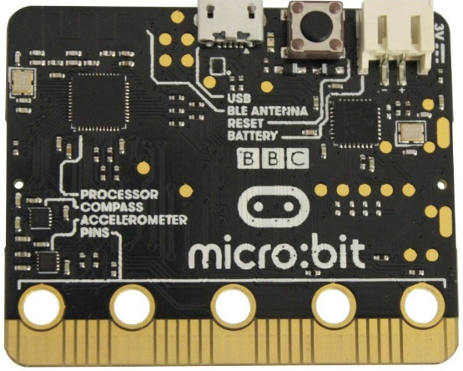

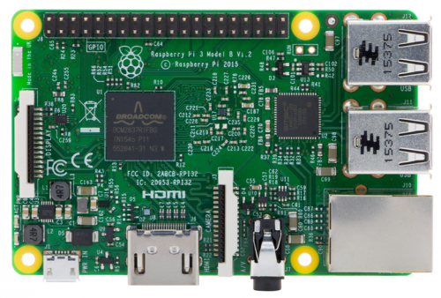
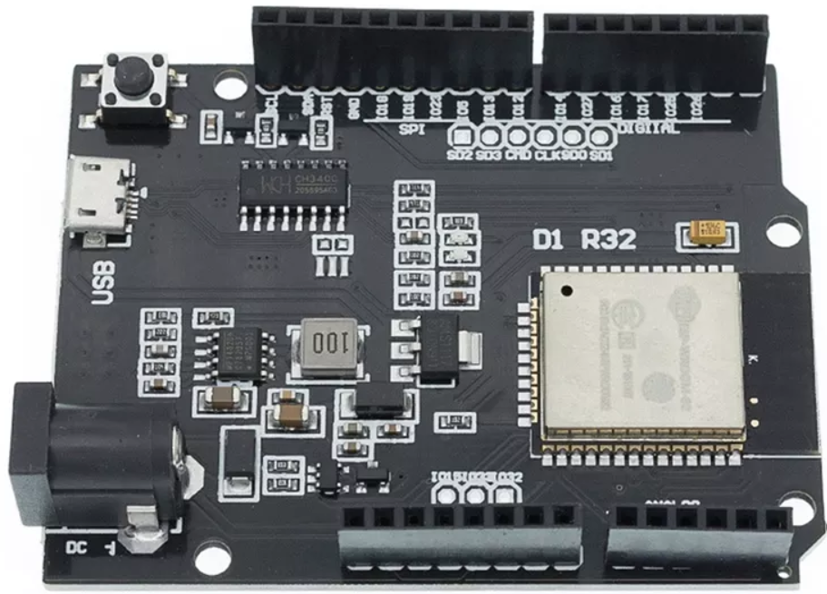
Overview of Single-board Microcontrollers (cont.)
Single-board microcontrollers (left) versus single-board computer (right).
micro:bit (V1), Arduino UNO and D1 R32 (clockwise)
Raspberry Pi

Slide 8
Overview of micro:bit
micro:bit is an ARM-based microcontroller designed by the BBC for use in computer education in the UK:
A.k.a. BBC Micro Bit, stylised as micro:bit.
ARM stands for Advanced RISC Machine.
RISC stands for reduced instruction set computing.
Processors with RISC architecture typically require fewer transistors than those with a complex instruction set computing (CISC) architecture.
RISC improves cost, power consumption and heat dissipation.
Good for light, portable and battery-powered devices:
E.g., smartphones, laptops and tablet computers, and other embedded systems.

Slide 9
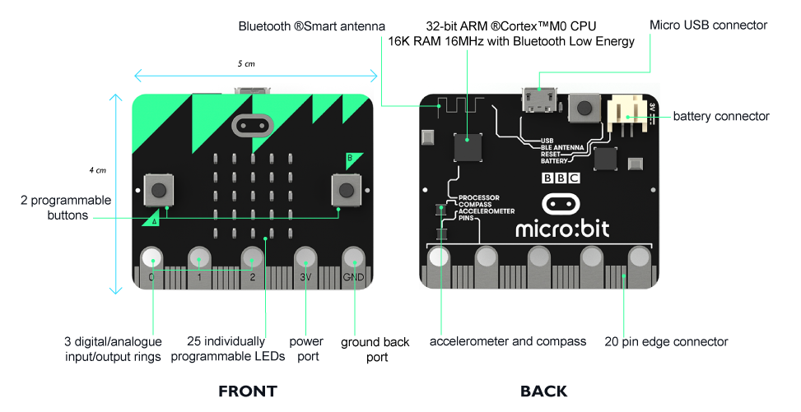
Overview of micro:bit (cont.)

Slide 10
Overview of micro:bit (cont.)
The board of micro:bit is 4 cm x 5 cm, described as “half the size of a credit card”:
Contains an ARM Cortex-M0 processor.
On board motion (accelerometer, compass, magnetometer), temperature and light sensors.
Wired connectivity via micro-USB.
Wireless connectivity via Bluetooth and Radio.
On board output display consisting of 25 LEDs.
On board input via two programmable buttons (A and B).
Powered by either USB or an external battery pack (2 x AAA).
Device inputs and outputs are done through five ring connectors that are part of the 25-pin edge connector.

Slide 11
Features of micro:bit
25 individually-programmable LEDs:
Can display text, numbers and images.
Uses a scrolling interface.
2 programmable buttons:
Buttons are labelled as A and B.
Can detect when these buttons are pressed.
These buttons can be used to trigger code on the device.
Physical connection pins:
There are 25 external connections or “pins” on the edge connector (5 large pins and 20 small pins).
Can program LEDs, motors or other electrical components with the pins, or connect extra sensors.

Slide 12
Features of micro:bit (cont.)
Light sensor:
Uses some of the LEDs on the LED screen to measures the ambient light (how bright or dark it is).
Light level 0 means darkness and 255 means bright light.
Temperature sensor:
Measures the current ambient temperature, in degrees Celsius.
Accelerometer:
Measures the acceleration of the micro:bit.
Senses when the micro:bit is moved.
It can also detect other actions, e.g., shake, tilt and free-fall.

Slide 13
Features of micro:bit (cont.)
Compass:
Detects the earth’s magnetic field, and thus which direction the micro:bit is facing.
The compass has to be calibrated before it can be used to ensures the compass results are accurate.
Radio:
Allows micro:bits to communicate wirelessly among themselves.
Use the radio to send messages to other micro:bits, build multiplayer games and implement other use cases.

Slide 14
Features of micro:bit (cont.)
BLE (Bluetooth Low Energy) antenna:
Allows the micro:bit to send and receive Bluetooth signals.
Performs wireless communication with single-board computers, personal computers, phones and tablets:
E.g., can control micro:bit from a phone and send code wirelessly to the device from the phone.
Before using the Bluetooth antenna, need to pair micro:bit with the other device.
USB interface:
Connect the micro:bit to a computer via a micro-USB cable.
Power the device and download program onto the device.

Slide 15
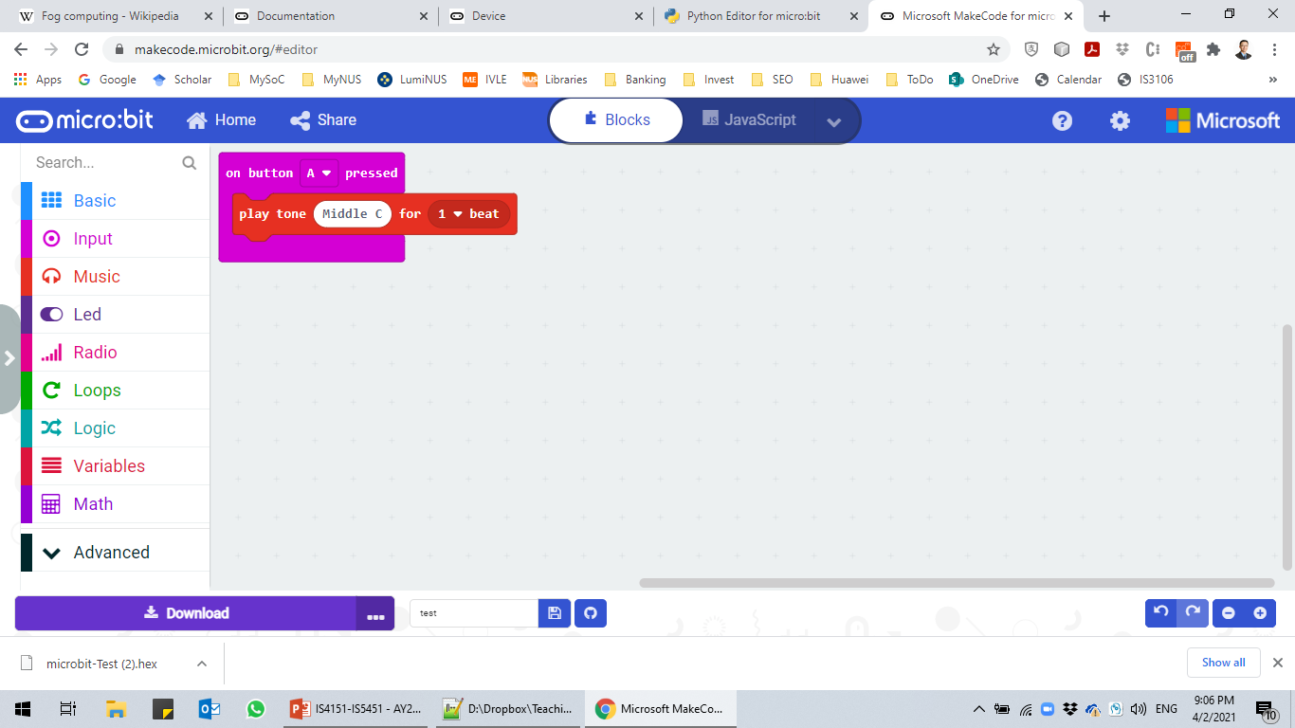
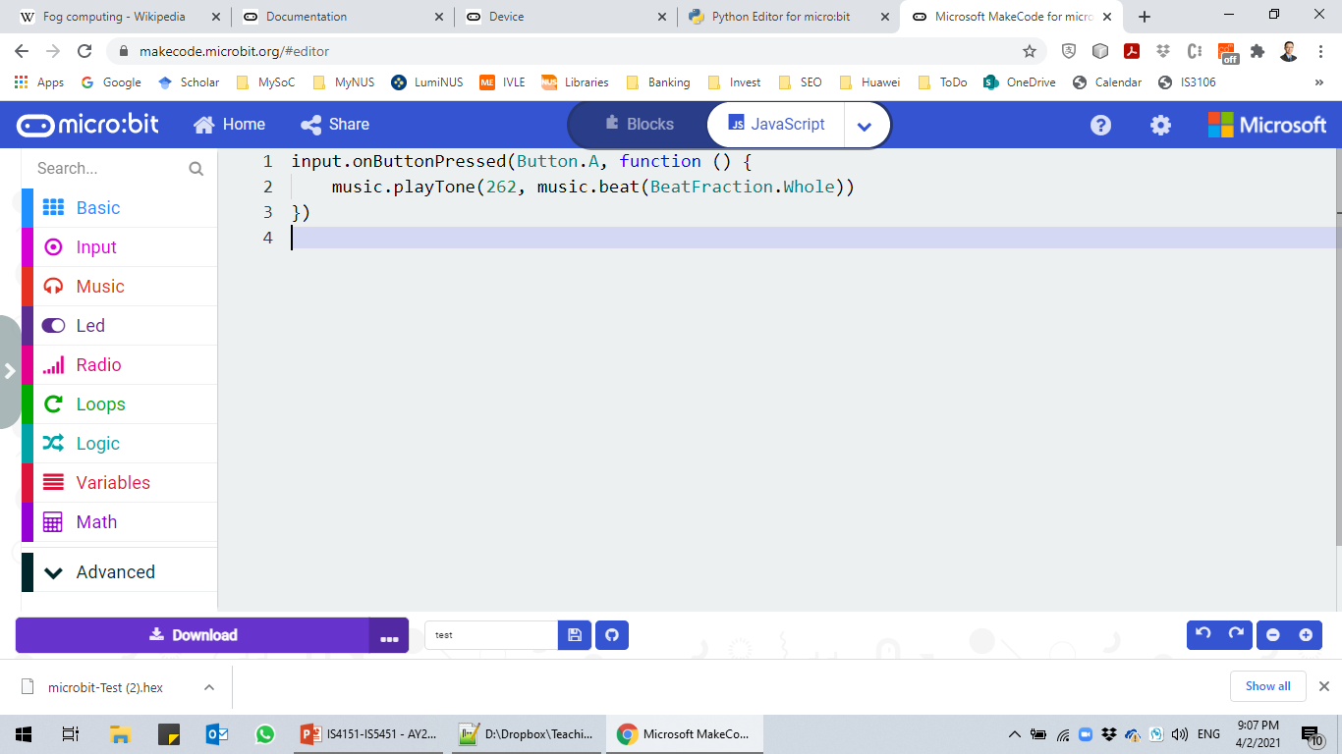
Programming the micro:bit
Microsoft MakeCode Editor:
JavaScript Blocks Editor that supports visual programming (blocks to JavaScript) – https://makecode.microbit.org
MakeCode (based on PXT) compiles the JavaScript to ARM Thumb assembly, then links it against a pre-compiled .hex file of mbed + micro:bit runtime.
The .hex file is then downloaded to your micro:bit for flashing.
src00.js

Slide 16
Programming the micro:bit (cont.)
Python Editor:
Python is a very popular high-level programming language.
MicroPython is a lean version of Python specifically designed to run on microcontrollers (like the ARM Cortex-M0 on the micro:bit).
There are several ways to code in Python on the micro:bit:
Latest version of Microsoft MakeCode Editor provides integrated language support for blocks to Python – https://makecode.microbit.org
Standalone Python Editor on the official micro:bit website – https://python.microbit.org/v/beta
MakeCode Editor uses procedural style whereas standalone Python editor uses an infinite main control loop.

Slide 17
micro:bit as a Reactive System
micro:bit is a reactive system:
It reacts continuously to external events, such as a person pressing the A button or shaking the device.
The reaction to an event may be to perform a computation, update variables and change the display.
After the device reacts to an event, it is ready to react to the next one.
E.g., most computer games are reactive systems.
Reactive systems need to be responsive, i.e., react in a timely manner to events.
To be responsive, a reactive system needs to be able to do several things at the same time, i.e., concurrently.

Slide 18
micro:bit as a Reactive System (cont.)
But the micro:bit only has one CPU for executing program:
It can only execute one program instruction at a time.
However, it can execute millions of instructions in a single second.
The micro:bit’s scheduler provides the capability to concurrently execute different code sequences:
The first job of the scheduler is to allow multiple subprograms to be queued up for later execution.
The second job of the scheduler is to periodically interrupt execution to read (poll) the various inputs to the micro:bit (the buttons, pins, etc.) and fire off events (such as “button A pressed”).

Slide 19
micro:bit as a Reactive System (cont.)
The firing of an event causes the event handler subprogram associated with that event to be queued for later execution.
The scheduler uses a timer built into the hardware to interrupt execution every 6 milliseconds and poll the inputs.
The micro:bit’s scheduler is non-preemptive:
This means that the runtime will never take control away from a subprogram.
The scheduler will wait for a subprogram to either:
finish execution; or
make a call to a runtime function that is blocking.

Slide 20
Event Driven Programming with micro:bit
micro:bit uses an event-driven programming model.
An empty default micro:bit project consists of:
on start event handler:
Runs code when the program starts.
This is essentially the main() equivalent that contains code executed sequentially.
basic.forever loop:
Code in this loop runs forever in the background.
It is an infinite loop handling the basic logic of the micro:bit.
But it allows other code to run on each iteration.
All other code are written within event handlers that gets executed when the associated event is triggered.

Slide 21
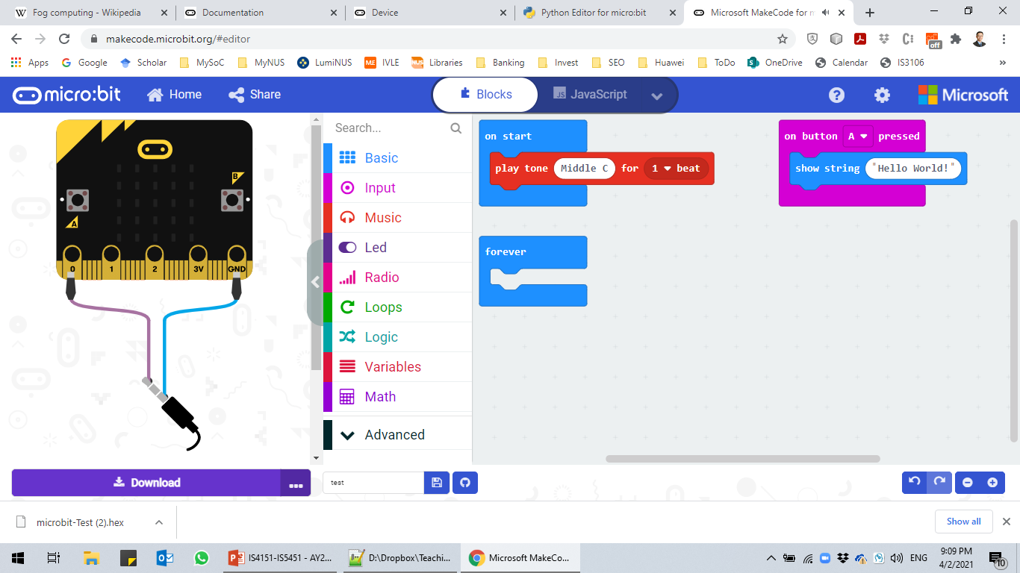
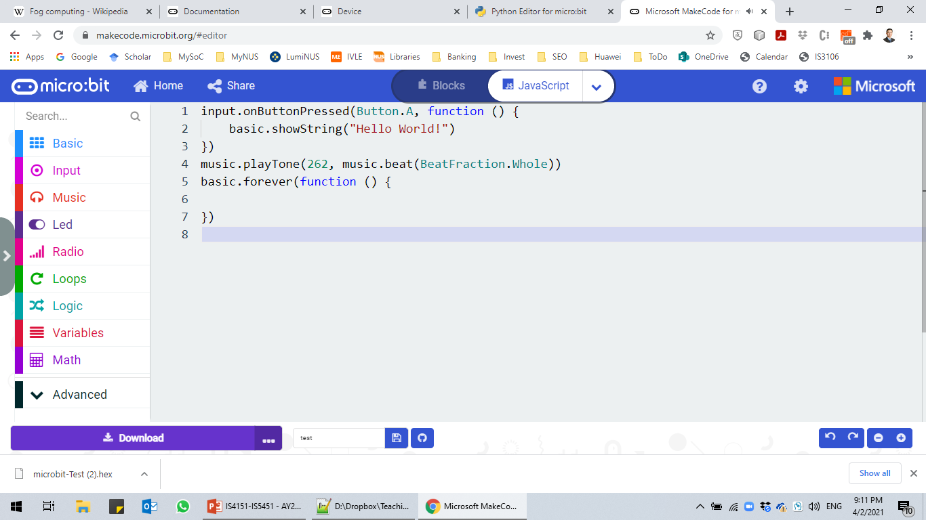
Event Driven Programming with micro:bit (cont.)
micro:bit version of “Hello World!”
src01.js

Slide 22
Cooperative Passing of Control
How does the forever loop get to start execution?
Furthermore, once the forever loop is running, how do any other subprograms (like event handlers) ever get a chance to execute?
The forever loop periodically and voluntarily pause its execution so that other subprograms can execute:
But the forever loop is not aware of other subprograms.
Thus, the forever loop (and other subprograms) passes control of execution back to the scheduler.
The scheduler then determines the next subprogram to pass control to.

Slide 23
Round-robin Scheduling
The third and final job of the scheduler is to determine which is the next subprogram to pass control to.
The scheduler uses two queues to perform this task:
The run queue contains all non-sleeping subprograms, such as the event handlers queued by the firing of events.
The sleep queue contains previously running subprograms that have called the pause function and still have time left to sleep.
The scheduler moves the subprogram that has just paused into the sleep queue.
Then removes the subprogram at the head of the run queue and resumes its execution.
Once a subprogram’s sleep period is over, the scheduler moves it from the sleep queue to the back of the run queue.

Slide 24
Round-robin Scheduling (cont.)
Round-robin scheduling assumes that every subprogram:
Eventually runs to completion; or
Periodically enters the sleep queue.
In this way, every subprogram will periodically get a chance to execute.
Essentially, the micro:bit scheduler enables us to create a program that is composed of concurrent subprograms easily:
We do not need to worry about the low-level programming.

Slide 25
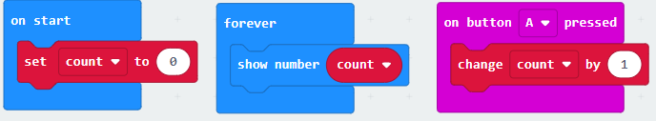
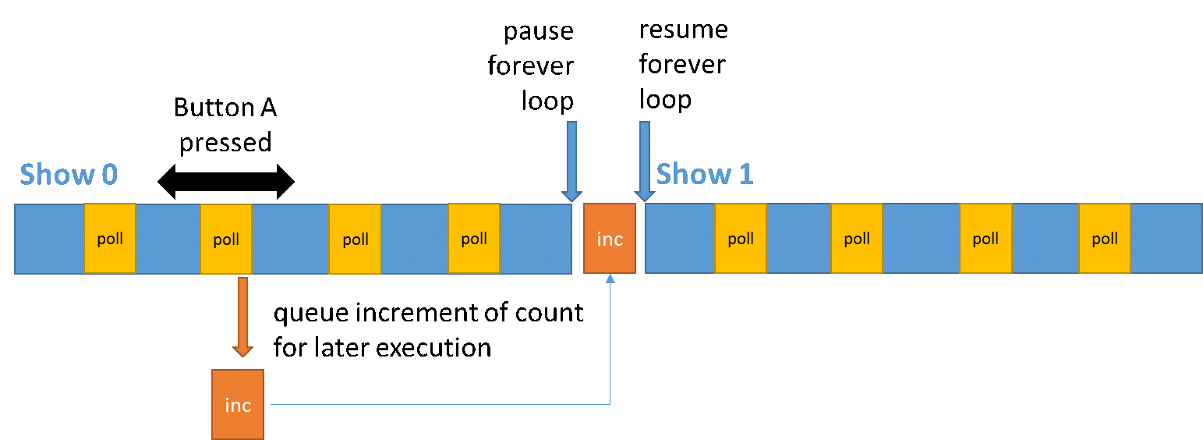
Round-robin Scheduling (cont.)
rrschedule.js

Slide 26
Round-robin Scheduling (cont.)
Recall that micro:bit’s scheduler is non-preemptive and assumes that every subprogram periodically pauses:
What happens if a subprogram misbehaves and refuses to pause?
In such a scenario, the forever loop and other subprograms would not be able to run.
But the scheduler’s interrupt mechanism would still be able to respond and queue event handlers for future execution.
An event would not be lost unless it triggers faster than 6 milliseconds.

Slide 27
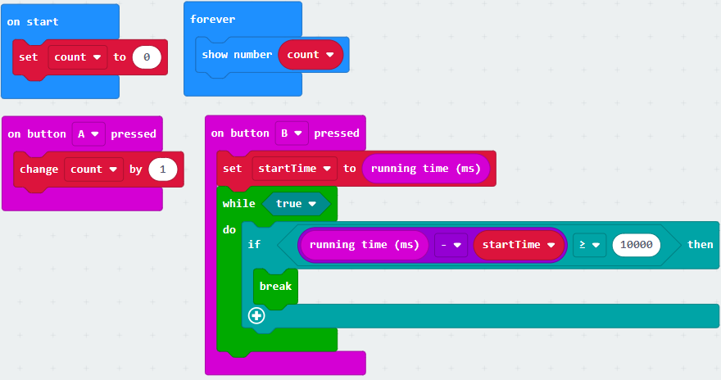
Round-robin Scheduling (cont.)
rrscheduleblocking.js

Slide 28
Variables and Operators
You can define variables for holding micro:bit’s state.
The let statement is used to declare a block scope local variable and optionally initialising it to a value.
In JavaScript, variables are dynamically typed and in general you can manipulate the following primitive data types:
Data Type | Description
String | Represents sequence of characters, e.g., “hello”
Number | Represents numeric values, e.g. ,100
Boolean | Represents boolean value either false or true
Undefined | Represents undefined value
Null | Represents null, i.e., no value at all

Slide 29
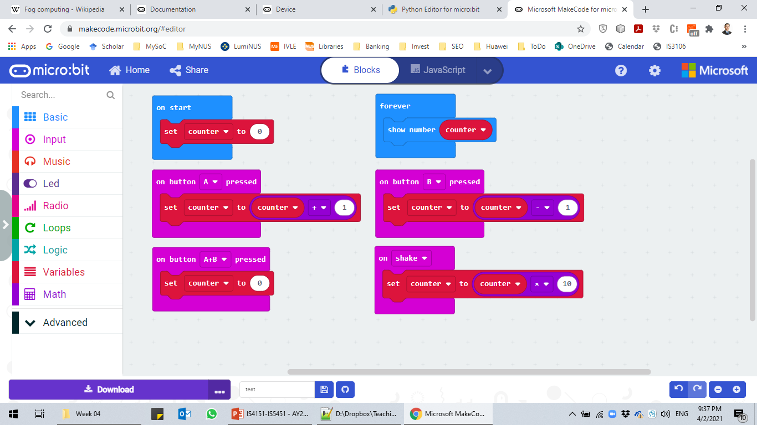
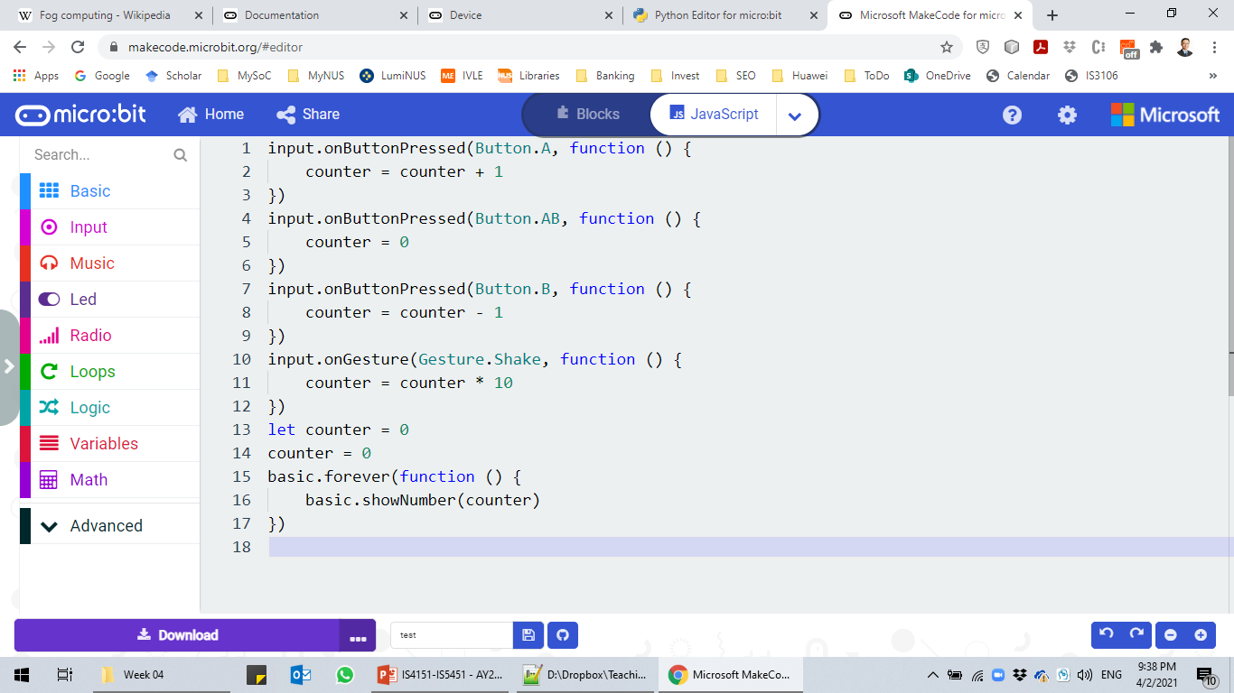
Variables and Operators (cont.)
Simple example of visitor counter:
Use a single number counting variable initialised to 0.
Perform some simple arithmetic operations on the variable.
src02.js

Slide 30
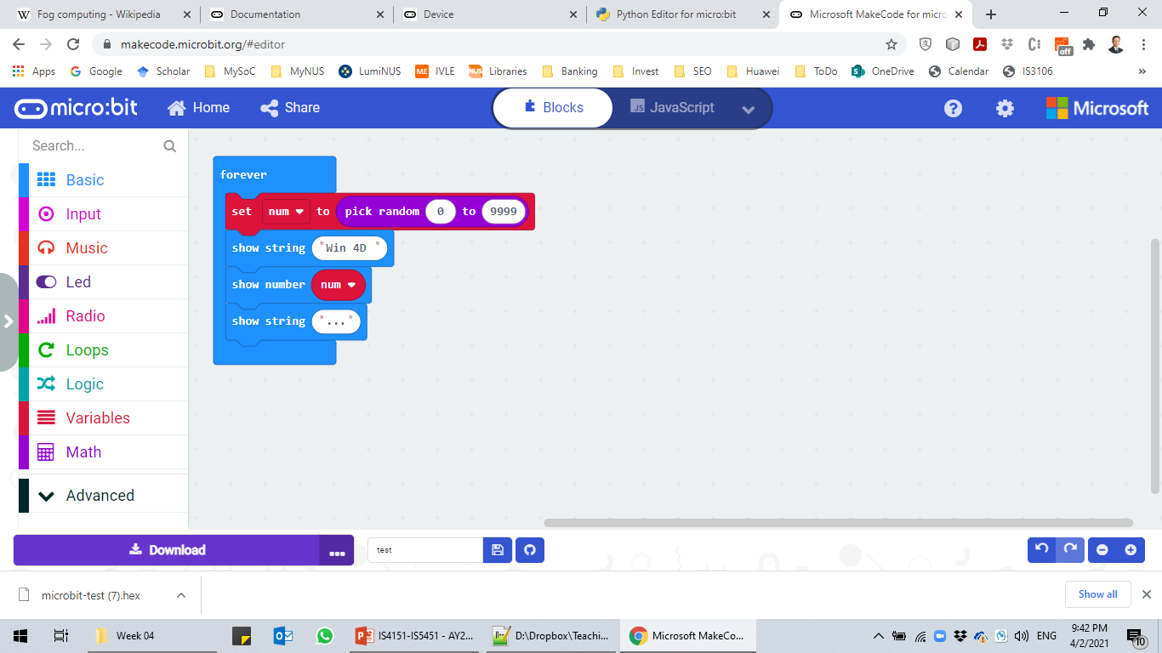
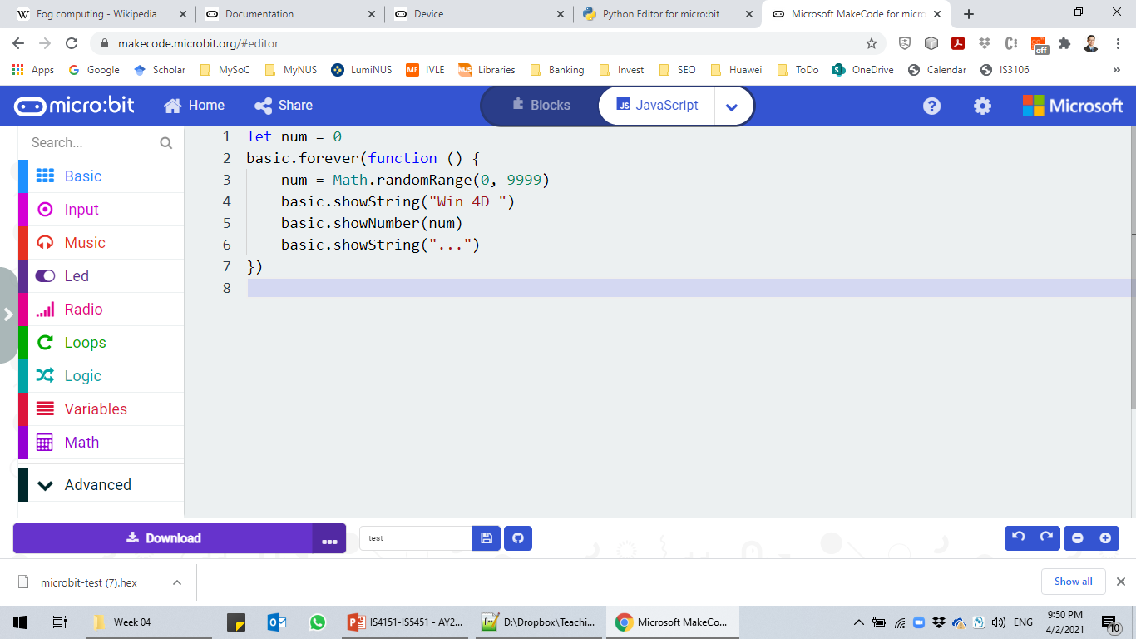
Variables and Operators (cont.)
You can also perform advanced mathematical operations with your micro:bit:
Math.randomRange() can be used to generate a random number between 0 (inclusive) and limit (inclusive).
src03.js

Slide 31
Variables and Operators (cont.)
Is there any potential problem with sample code src03.js?
What is the problem?
How can you solve the problem?
The JavaScript runtime in micro:bit does not support string padding.
Thus, we need to manually pad the 4D number with 0s.

Slide 32
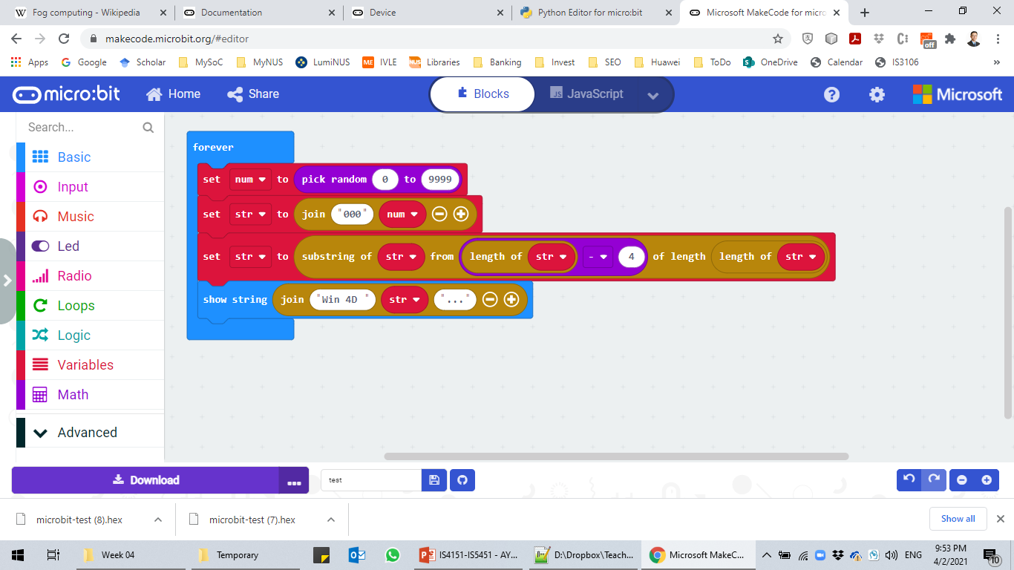
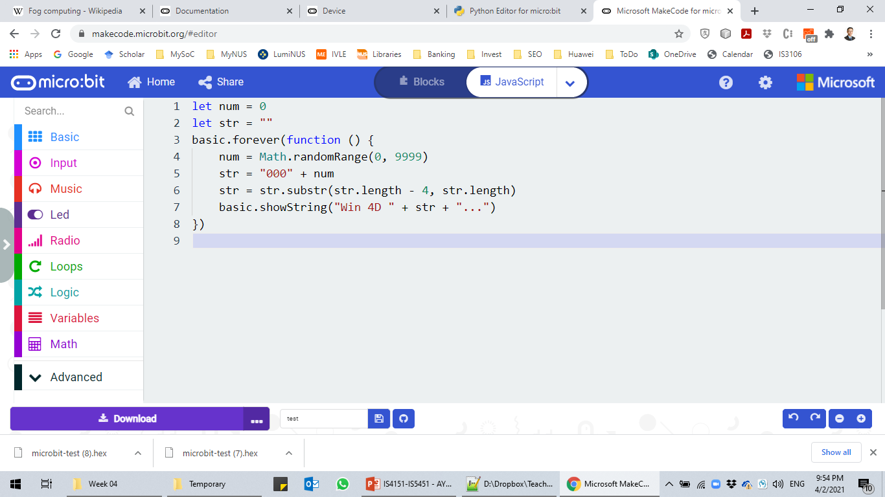
Variables and Operators (cont.)
src04.js

Slide 33
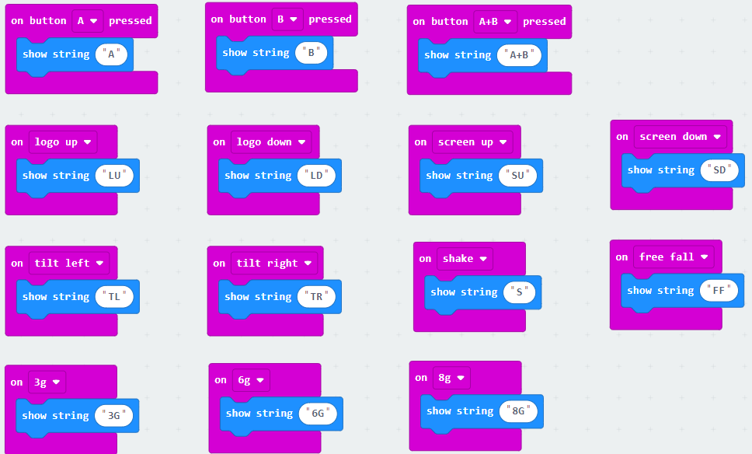
Basic Input/Output
Input can be obtained from user via:
Buttons – A, B or A+B
Gesture:
Movement – shake, logo up, logo down, screen up, screen down, tilt left, tilt right, free fall
Amount of g force being applied – 3g, 6g, 8g
Pin Pressed – Pin 0, Pin 1 or Pin 2 (GPIO ADC)
Sensors are classified as input too and we will come to that later.
src05.js

Slide 34
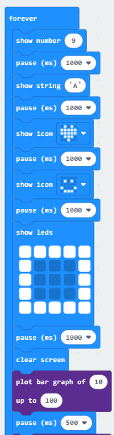
Basic Input/Output (cont.)
Onboard output is achieved using the 25 individually-programmable LEDs (5 by 5):
Show numbers.
Show string.
Show predefined icons.
Show LEDs by controlling which of the individual LED gets turned on/off.
Advanced output can be achieved by:
(Un)Plotting a x,y coordinate
Toggling a x,y coordinate
Plot a graph of n to max.
src06.js

Slide 35
Conditional Control Flow
Standard JavaScript conditional control flow with if statement can be used in micro:bit:
if statement for optional action.
if … else for alternative actions.
if … else if … else for multiple alternative actions.
Relational operators can be used for comparison – =, !=, <, <=, > and >=.
micro:bit also supports the and as well as or boolean operators to form complex expressions.
Easier to edit the JavaScript directly.

Slide 36
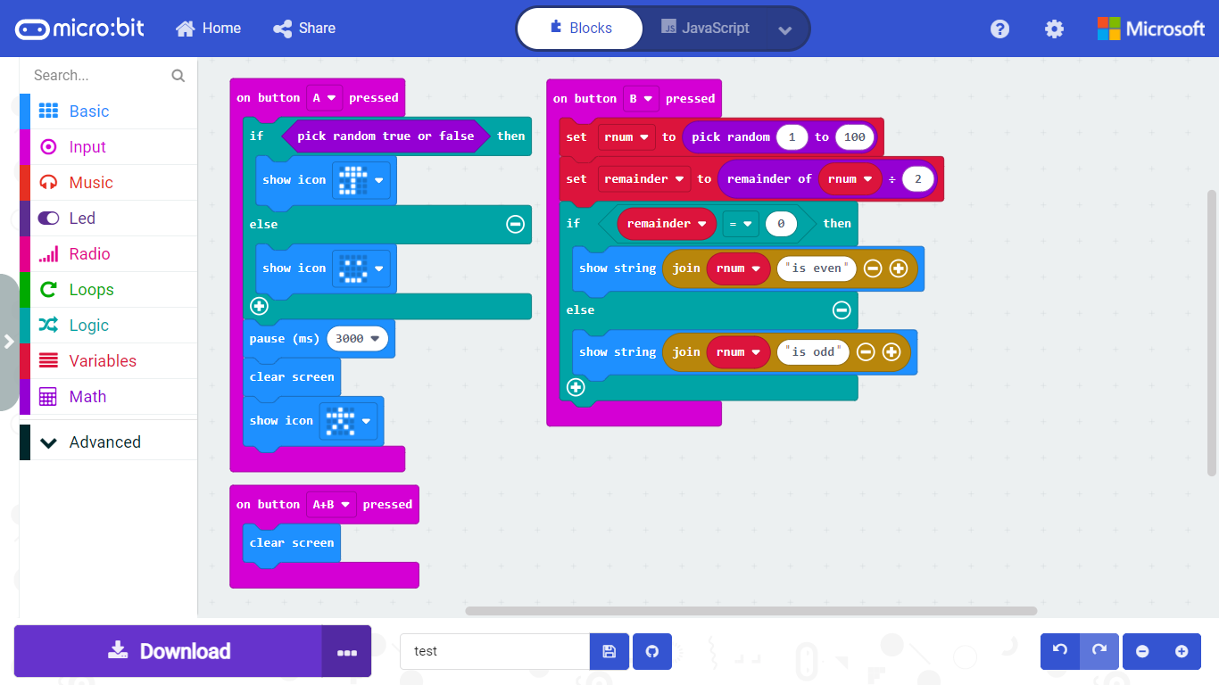
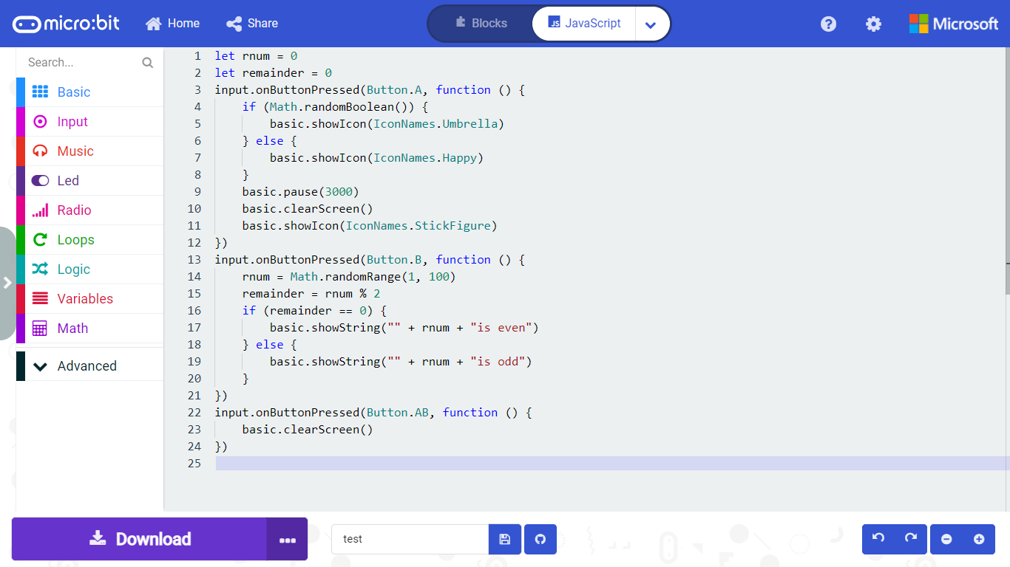
Conditional Control Flow (cont.)
src07.js

Slide 37
Iterative Control Flow
Standard JavaScript iterative control flow can be used in micro:bit:
while statement for general looping base on a boolean condition.
for statement for looping with a counting variable.
for...of statement iterating through a list.
It is also possible to define functions, including parameterised functions, to reuse JavaScript code in micro:bit.
Procedural programming is useful once the micro:bit program becomes big.

Slide 38
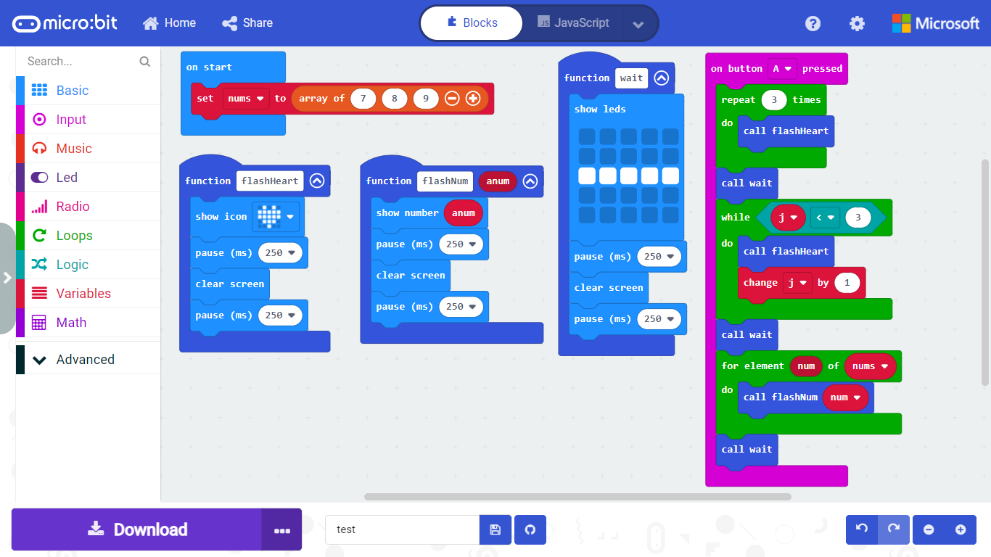
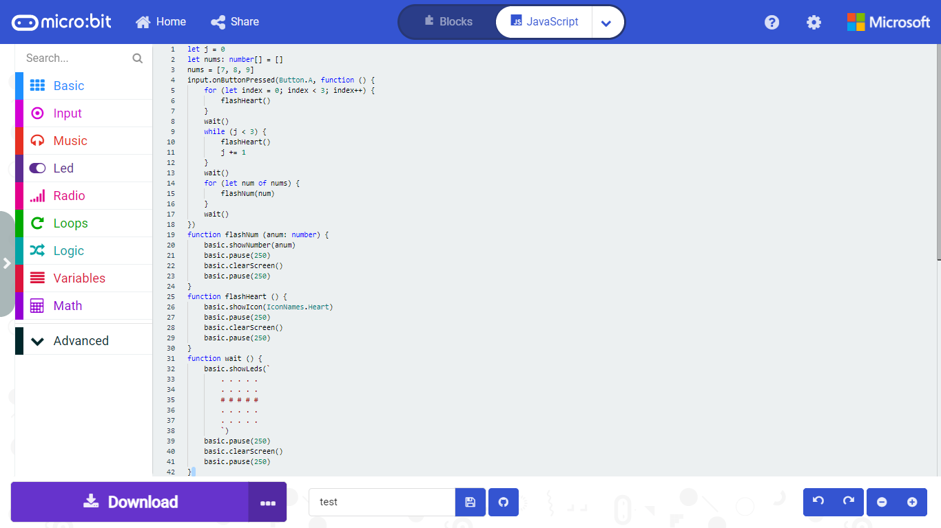
Iterative Control Flow (cont.)
src08.js

Slide 39
Sensors Input
micro:bit onboard sensors can be read easily:
Data value can be displayed on the LEDs; or
Perform further processing.
The following sensor data can be obtained:
Sensor Data | Description
compassHeading | Get the current compass heading in degrees
temperature | Get the temperature in Celsius degrees
acceleration | Get the acceleration value in milli-gravitys (when the board is laying flat with the screen up, x=0, y=0 and z=-1024).
lightLevel | Reads the light level applied to the LED screen in a range from “0” (dark) to “255” (bright).
rotation | The pitch or roll of the device, rotation along the “x-axis” or “y-axis”, in degrees.
magneticForce | Get the magnetic force value in “micro-Teslas” (“µT”)

Slide 40
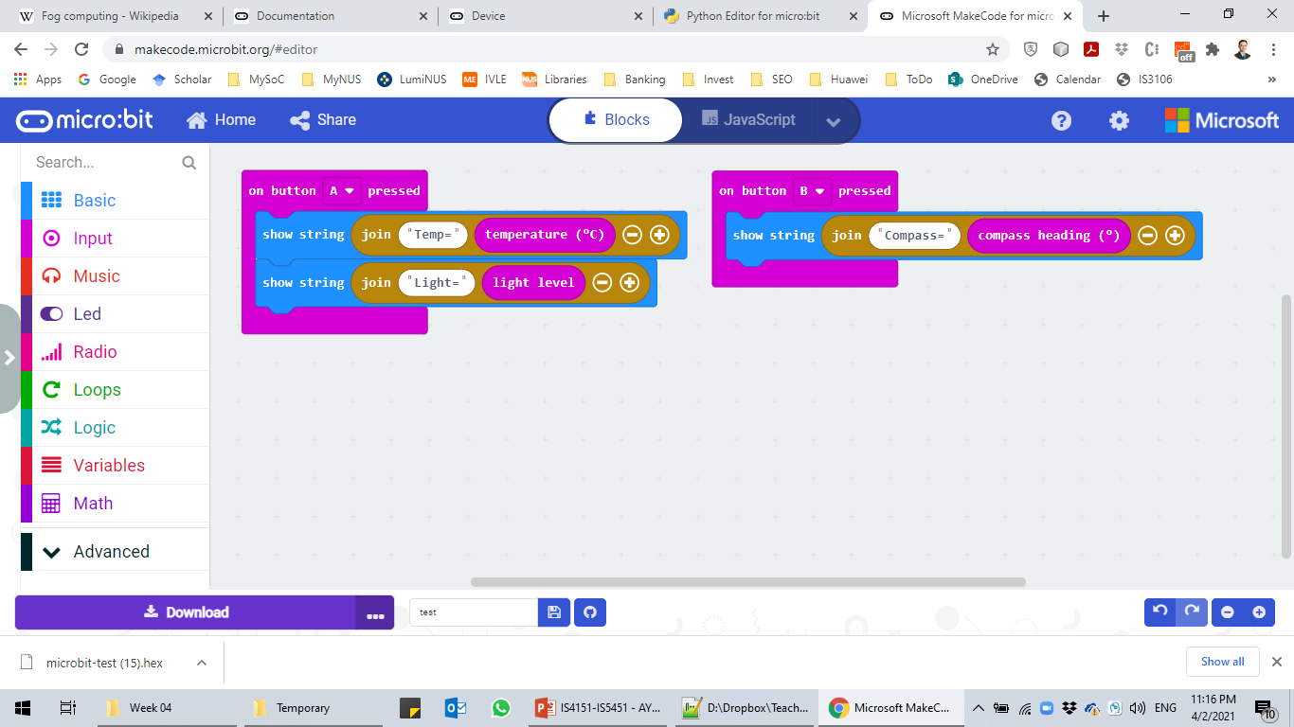

Sensors Input (cont.)
src09.js

Slide 41
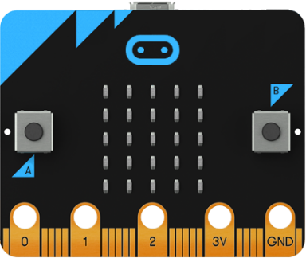
Sensors Input (cont.)
Compass heading is read with the:
micro:bit’s logo facing up and the microcontroller flat.
The front of the micro:bit pointing at the required direction.
North – 0/360
West – 270
East – 90
South – 180

Slide 42
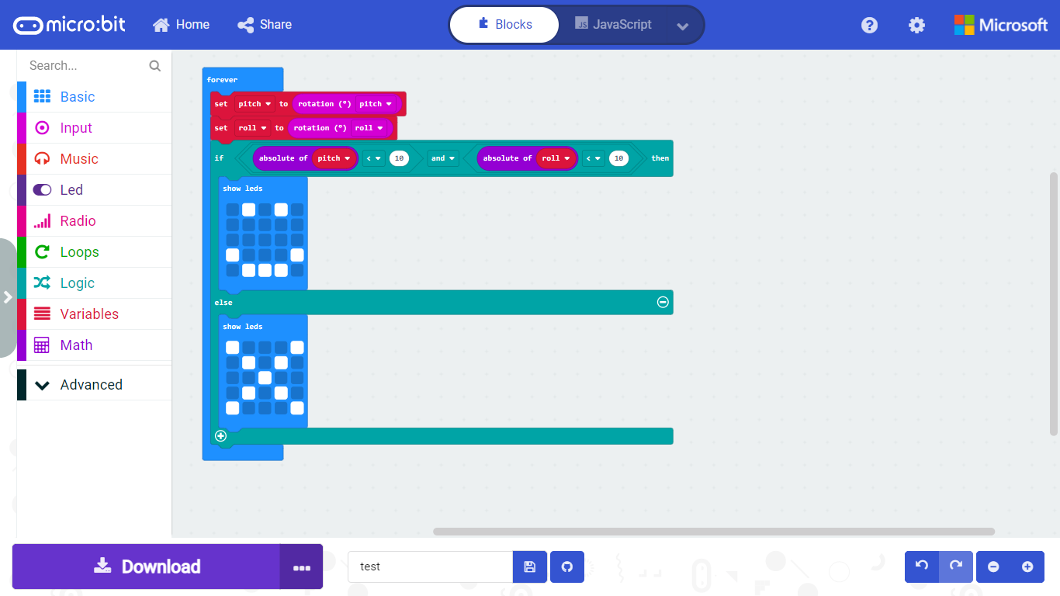
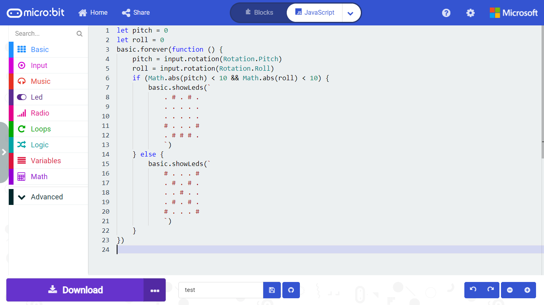
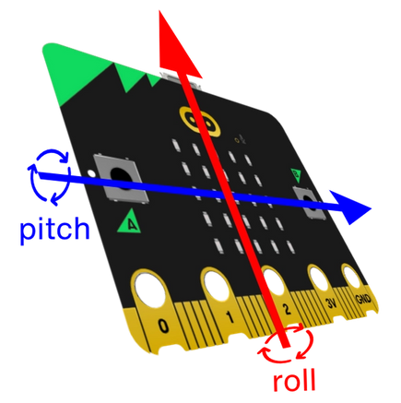
Sensors Input (cont.)
src10.js

Slide 43
Wireless Communication
micro:bit supports two forms of wireless communication:
Radio (2.4 GHz) communication between two or more micro:bit devices.
Bluetooth Low Energy (BLE) communication between other non-micro:bit devices.
The central processing unit (CPU) of micro:bit is the Nordic Semiconductor nRF51822:
The nRF51 series combines Nordic Semiconductor’s 2.4GHz transceiver technology with the powerful but low power ARM Cortex-M0 core.
The built-in 2.4GHz radio module can be configured in a number of ways and is primarily designed to run the BLE protocol.

Slide 44
Wireless Communication (cont.)
It can also be placed into a much simpler mode of operation that allows simple, direct micro:bit to micro:bit communication.
However, it is not currently possible to run the Radio component and BLE at the same time:
If you want to use the Radio functionality, you need to disable the BLE stack on your micro:bit and vice-versa.

Slide 45
Radio Wireless Communication
A micro:bit device specifies a radio group ID from 0 to 255:
micro:bit can only send or receive in one group at a time.
If we load the very same program onto two different micro:bits, they will be able to talk to each other because they will have the same radio group ID.
Transmission power is set from 0 (-30 dBm) to a strength of 7 (+4 dBm):
When operating in an open area with the highest transmission power of 7, a micro:bit signal can reach as far as 70 m.

Slide 46
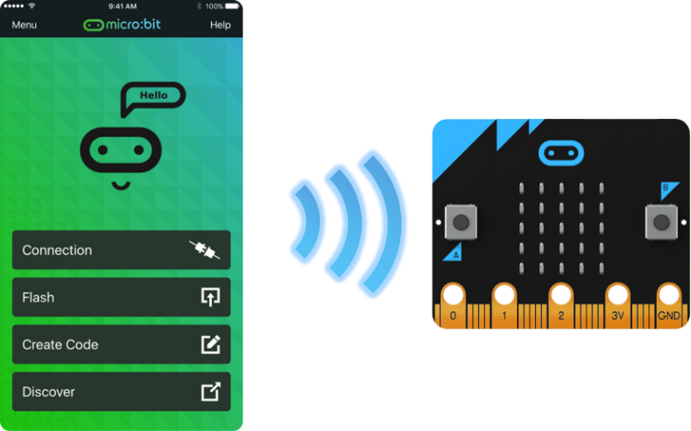
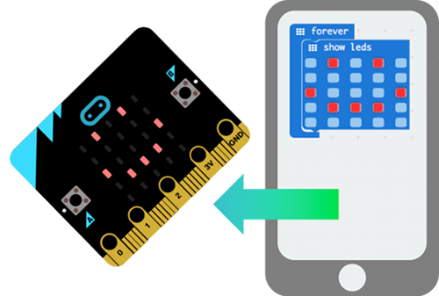
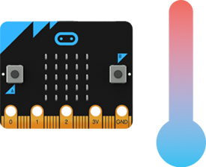
BLE Wireless Communication
A device such as a smartphone can use any of the Bluetooth “services” provided by a micro:bit.
However, it must first be paired with the micro:bit.
Once paired, the other device may connect to the micro:bit and exchange data relating to many of the micro:bit’s features.
Data communication can take place both ways, but each “service” is unidirectional.

Slide 47
BLE Wireless Communication (cont.)
Examples:
The Bluetooth button service allows the micro:bit to notify the other device about the three possible states (not pressed, pressed and long press) of each of the two buttons.
On the contrary, the Bluetooth LED service allow the other device to control the 25 LEDs on the micro:bit by writing string data or toggling individual LED.
The former is micro:bit-to-device while the latter is device-to-micro:bit.
On an Android phone, you can use the Bitty Blue app for demonstration.

Slide 48
Programming Radio Wireless Communication
There are two basic use cases for peer-to-peer radio communication between two or more micro:bit devices.
Exchanging data:
micro:bit can send a number, string or a name-value pair.
Number – micro:bit supports signed 32-bit integer.
String – Maximum string length is 19 characters.
Name-value pair – Maximum string length of the key is 8 characters.

Slide 49
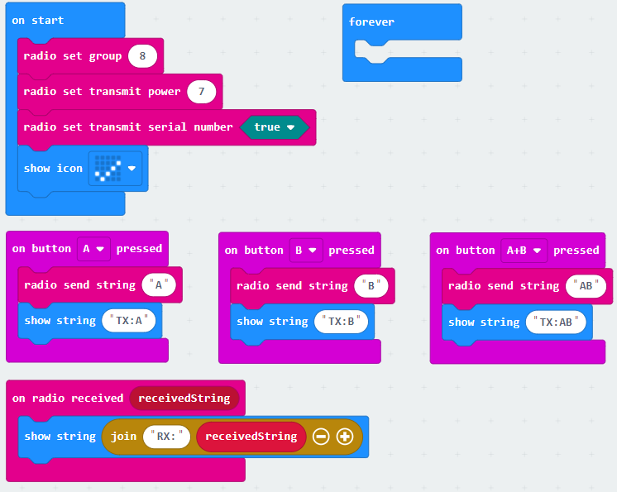
Programming Radio Wireless Communication (cont.)
src11.js

Slide 50
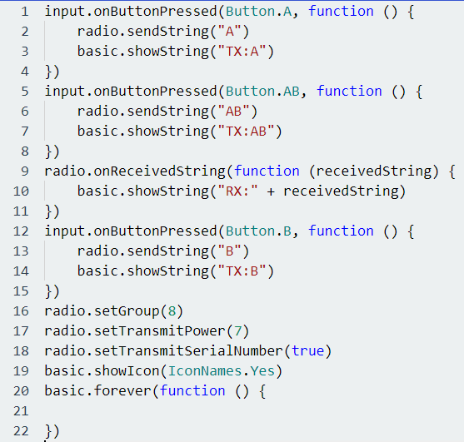
Programming Radio Wireless Communication (cont.)
src11.js

Slide 51
Programming Radio Wireless Communication (cont.)
There are three radio sending blocks and three matching radio receiving blocks:
One pair for each of number, string and name-value pair.
Do take note of the difference in the maximum string length between string (19 characters) and the key of the name-value pair (8 characters).

Slide 52
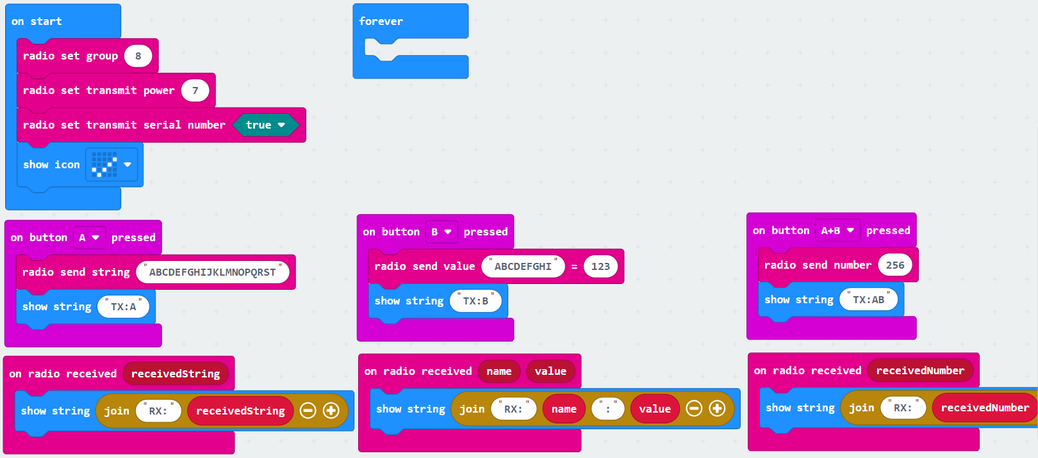
Programming Radio Wireless Communication (cont.)
src12.js

Slide 53
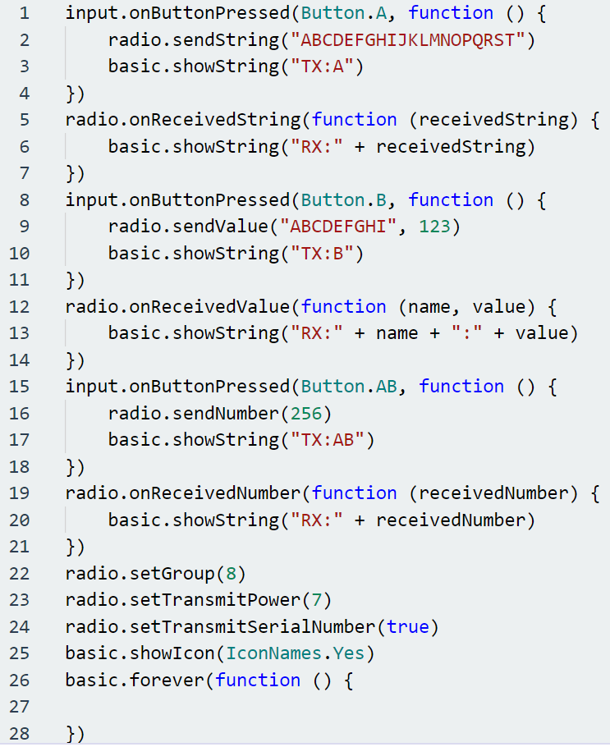
Programming Radio Wireless Communication (cont.)
src12.js

Slide 54
Programming Radio Wireless Communication (cont.)
The radio.receivedPacket block allows us to retrieve the following properties of the last received radio packet:
time – The system time of the micro:bit (elapsed time since the start of the program in ms) that sent this packet at the time the packet was sent.
serial – The serial number of the micro:bit that sent this packet, or 0 if the micro:bit did not include its serial number.
signal – How strong the radio signal is from -128 (weak) to -42 (strong).

Slide 55
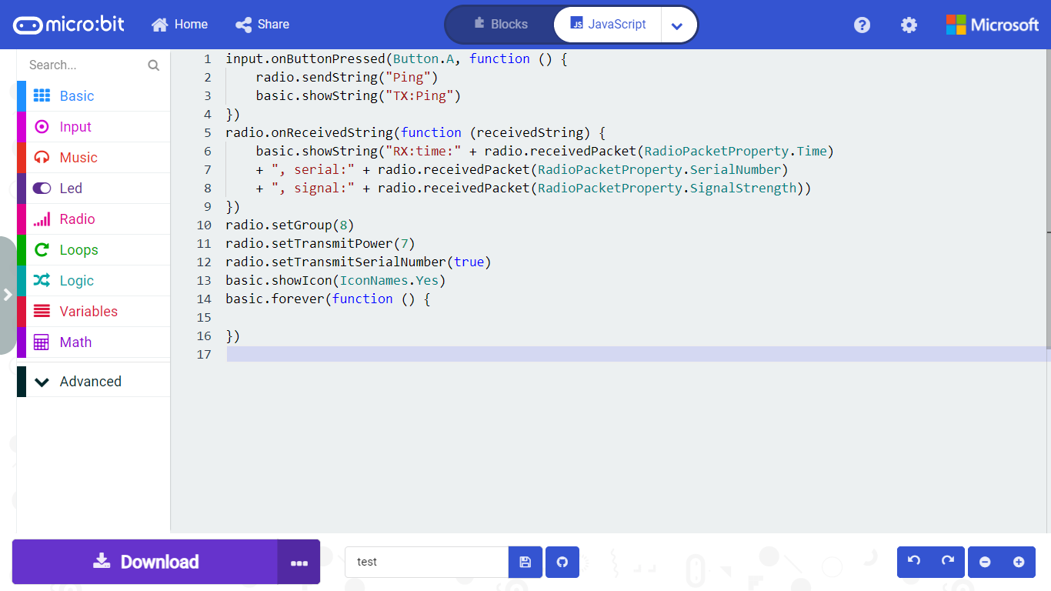
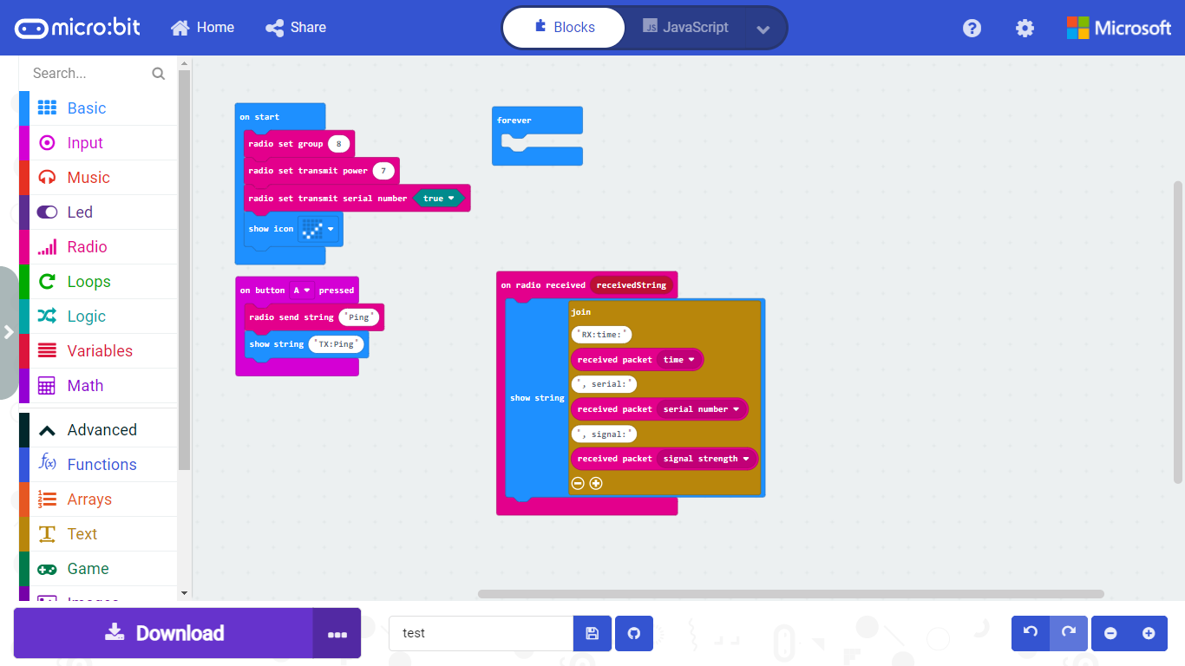
Programming Radio Wireless Communication (cont.)
src13.js

Slide 56
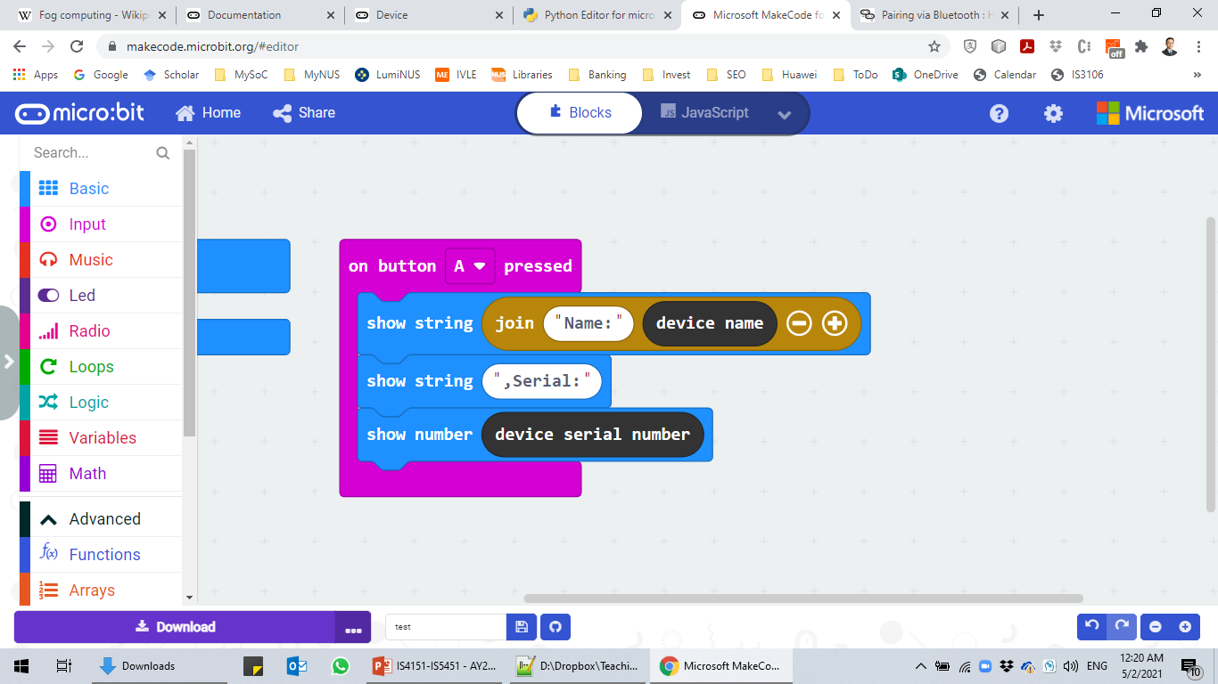
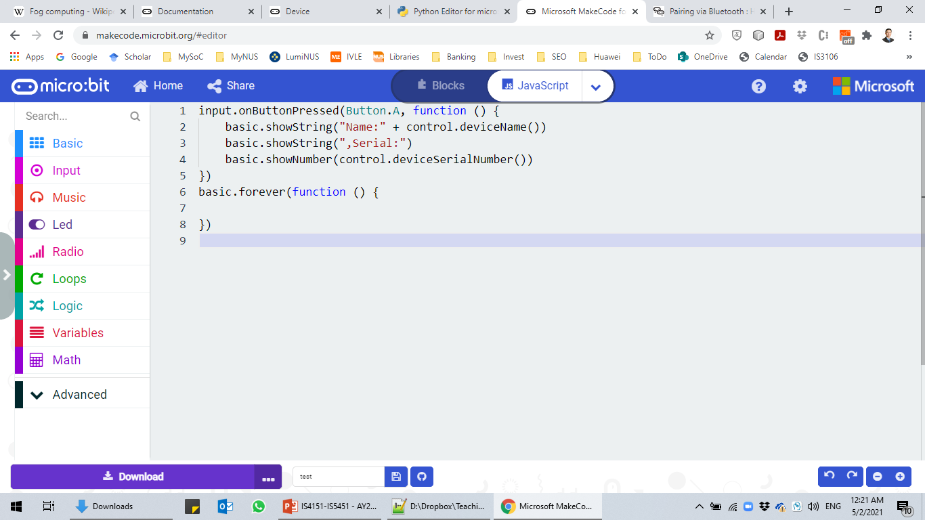
Programming Radio Wireless Communication (cont.)
Controlling another micro:bit device:
We can extend the base use case for exchanging data to send commands to other micro:bit devices.
The receiving micro:bit devices then take certain actions and may reply to the controlling device.
By using the device serial number, we can identify the sending device.
src14.js

Slide 57
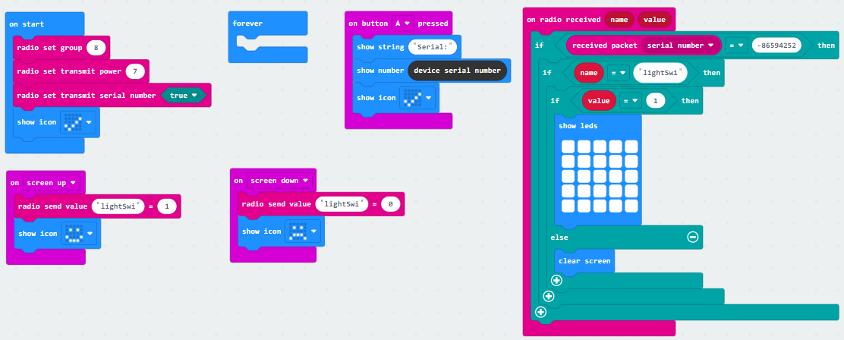
Programming Radio Wireless Communication (cont.)
src15.js

Slide 58

Programming Radio Wireless Communication (cont.)
src15.js

Slide 59
Data Structure
An Array is a list of items of a particular basic (primitive) type, e.g., numbers, strings or booleans.
Arrays have a length indicating the number of items they contain.
The values of items at different elements in an array can be accessed by a zero-based index number.
Arrays are flexible and can grow and shrink in size by adding and removing items at any place in the array:
push and pop – Append or delete an item to/from the end of the array.
insertAt() and removeAt() – Add or delete an item at the specified index position.

Slide 60
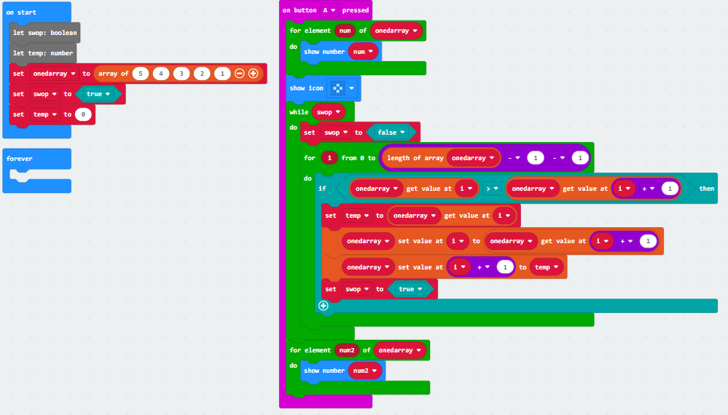
Data Structure (cont.)
src16.js

Slide 61
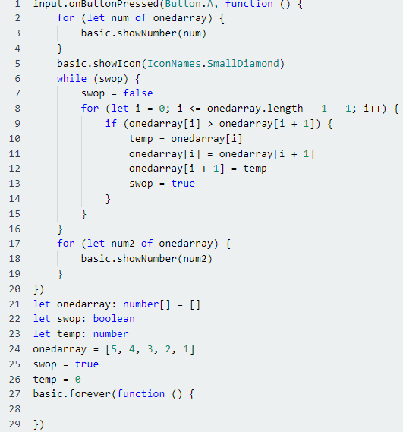
Data Structure (cont.)
src16.js

Slide 62

Summary
Micro:bit is a relatively powerful microcontroller with various onboard sensors.
The hard buttons and sensors allows micro:bit to obtain input from user and its environment.
The 25 LEDs provide some limited onboard output capability to micro:bit.
Micro:bit supports both radio and BLE wireless communication.
Micro:bit can be used to implement simple data structures and algorithms for supporting more complex computational use cases.

